Slide 1







Group Number
Digital Forensics & Cybercrime Datamining
Supervision by: Dr. Rakesh Kumar
Assistant Professor, Department- CEA
(201530002)
(201530015)
(201530021)
Aditi Saraswat
Kamini Sengar
Priyanka Singh

Slide 2





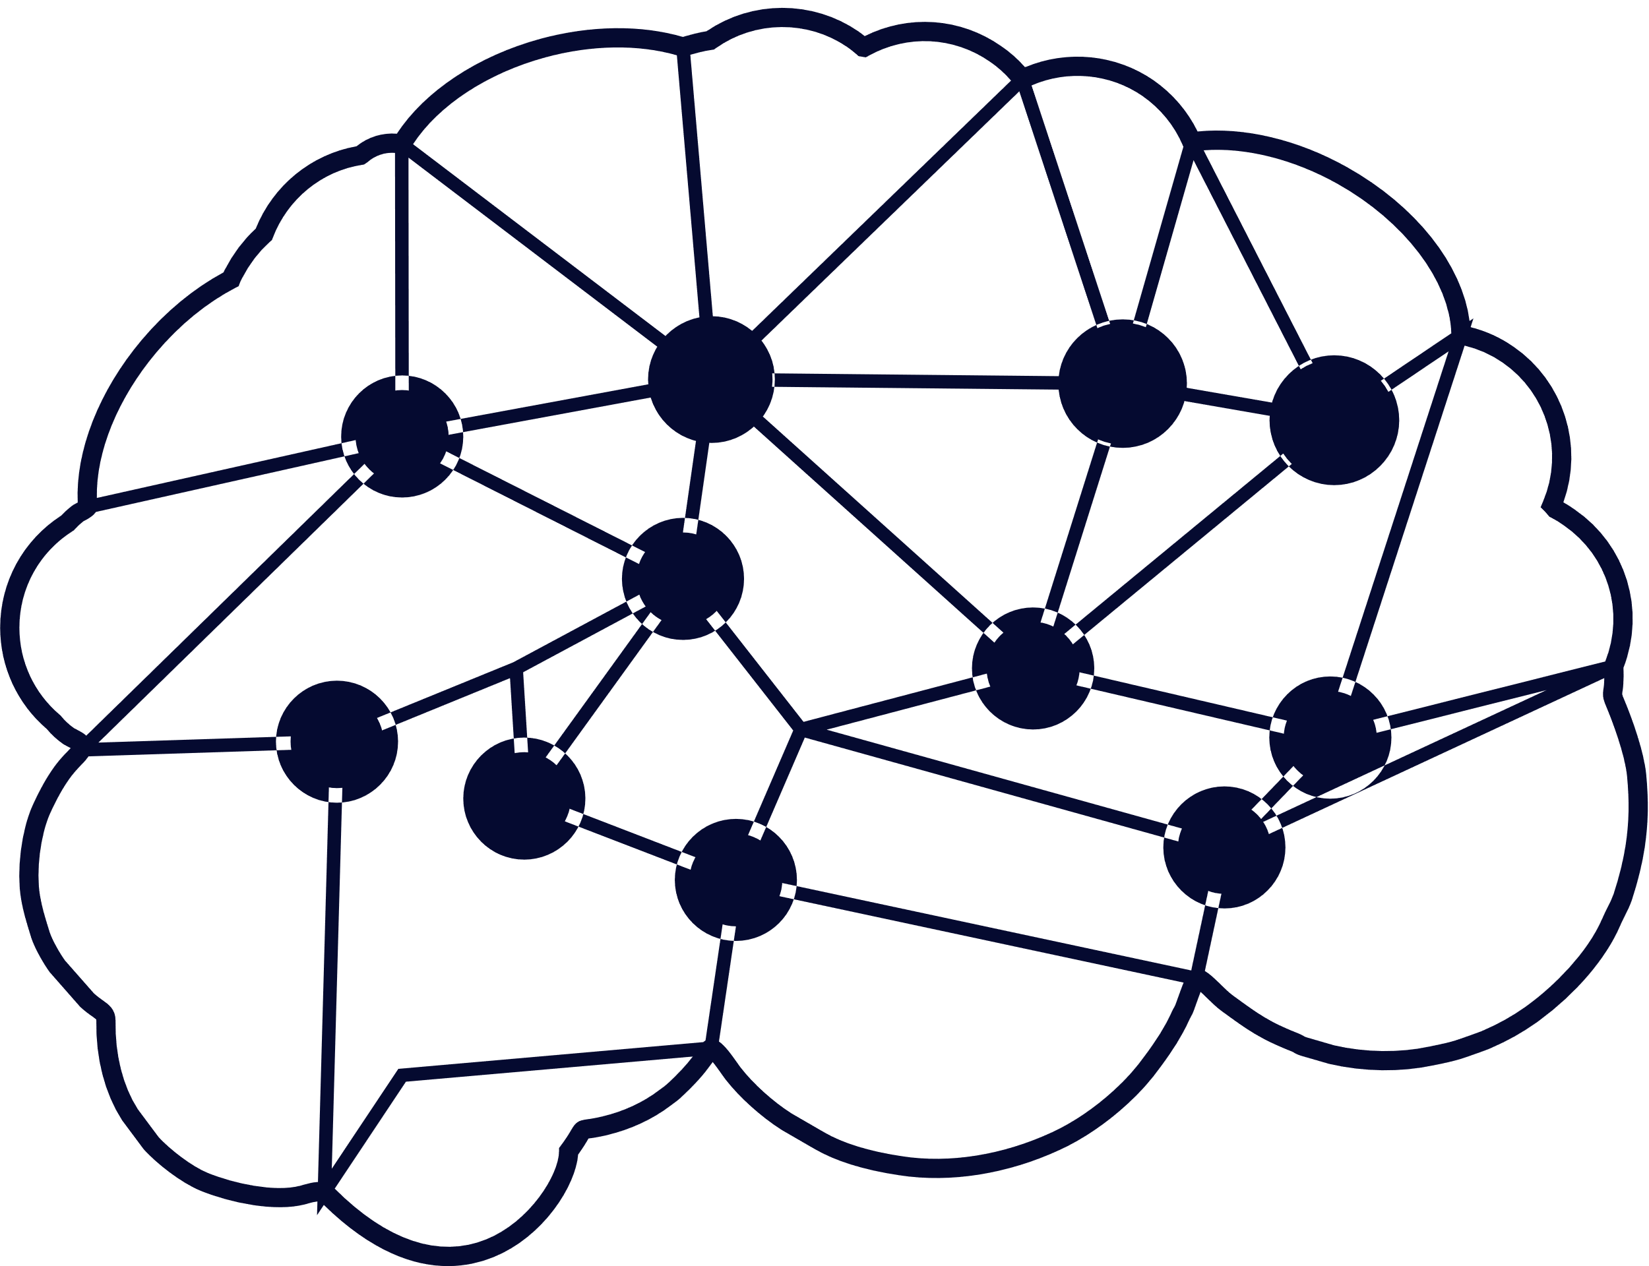
Index of Presentation
01
Introduction
04
Results & Experiments
02
Research Gap Motivation
05
Conclusion & Future Work
03
Proposed Methodology
06
References

Slide 3





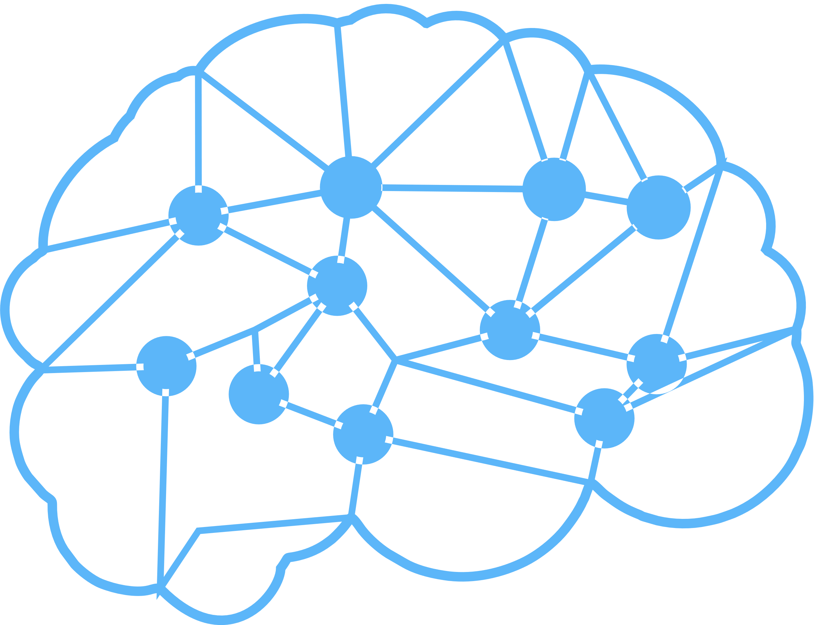
Introduction
Digital forensics and cyber crime data mining are crucial for investigating and prosecuting cyber criminals
Cybercrime has become an increasingly serious concern in recent years, with hackers and other cybercriminals using a range of techniques to steal sensitive information, disrupt networks, and cause other types of harm.
In India, cybercrime has been on the rise in recent years, with a total of 33,147 cybercrime cases reported in 2016, 44,679 cases reported in 2017
To better understand the trends and patterns of cybercrime in India, we have gathered a dataset of cybercrime incidents reported in different states from 2016 to 2018.
Notes:
- According to the National Crime Records Bureau (NCRB), cybercrime has been on the rise in recent years, with a total of 33K cybercrime cases reported in 2016, 44K cases reported in 2017 around 34% rise in cases from 2016 compared to 2017
And if we talk about recent, there is 63.5% increase in cyber crime in 2020 compared to 2019

Slide 4
Percentage Share of State/UT
Introduction
Continue...
By analyzing this dataset using data mining techniques, we can identify patterns and trends in cybercrime data and develop predictive models to forecast future crime rates.
This dataset includes information such as percentage share of state/UT, mid year projected population (in lakhs), rate of total cyber crimes, and can be used to develop predictive models using data mining techniques such as clustering, classification, and association analysis.
Our project uses Python and its libraries such as NumPy, Pandas, Scikit, and Seaborn, matplotlib to preprocess the data, build predictive models, and present the results in graphical form.
By analyzing this dataset and developing predictive models, we can gain insights into the factors that contribute to the increase in cybercrime rates in India and identify potential areas of concern that require targeted strategies to prevent and mitigate cyber threats.
Notes:
NumPy for linear algebra
Pandas for data processing and for taking input in the form of CSV file
Seaborn, matplotlib for visualization of the results in graphical form

Slide 5


Uses or Applications of Topic in Real Life Scenario
Identify patterns in cyber crime
Security Risk Management
Cybersecurity Training and Awareness
Incident Response Planning
Notes:
Identify patterns in cyber crime: Researchers can this tool to analyze large datasets and identify patterns in cyber crime, such as common attack methods or trends in cyber criminal behavior. This information can be used to improve cyber security measures and prevent future attacks.
Incident Response Planning: Using data mining and visualization techniques to develop incident response plans that outline the appropriate steps to take in the event of a cyber attack or breach.
Security Risk Management: Using data mining and visualization techniques to assess security risks and identify potential vulnerabilities in systems and networks, and develop risk management strategies to mitigate these risks.
Cybersecurity Training and Awareness: Using data mining and visualization techniques to develop and deliver training programs and awareness campaigns that educate individuals and organizations on the latest cybersecurity threats and best practices for protecting against them.

Slide 6




Research Gap and Motivation
Limited Free and Open Source Cybercrime Investigation Tools
Difficulty in Analyzing Cybercrime Data
Limited Research on Cybercrime Investigation Techniques
Increasing Need for Cybercrime Investigation
Notes:
Limited Free and Open Source Cybercrime Investigation Tools: There is a research gap in the availability of free and open-source tools for cybercrime investigation and digital forensics. Many existing tools are expensive or proprietary, which limits access for small organizations and individuals who may not have the resources to invest in expensive software.
Difficulty in Analyzing Cybercrime Data: Cybercrime data is often complex and difficult to analyze, which can hinder investigations and make it challenging to identify patterns and trends. This requires the development of more sophisticated techniques that can analyze large and complex datasets in real-time.
Limited Research on Cybercrime Investigation Techniques: There is a limited amount of research on cybercrime investigation techniques in India, specifically with regards to predicting cybercrime rates based on historical data. This calls for further research to develop more effective methods for cybercrime investigation and prediction.
Increasing Need for Cybercrime Investigation: With the increasing use of digital technologies in all aspects of society, the need for effective cybercrime investigation techniques is becoming more urgent. There is a growing threat of cybercrime, and it is essential to develop new and effective tools and techniques to combat these threats.

Slide 7


Proposed Methodology
Data Collection and Pre-processing
Data Mining
Trend analysis
Data Visualization
Open Source Development
Notes:
Data Collection and Pre-processing: Collecting relevant data for the analysis and cleaning it to remove any inconsistencies and ensure data quality.
Open source development: this tool will be developed as an open source tool, allowing for community contributions and collaboration. This will enable ongoing development and improvement of the tool over time.

Slide 8
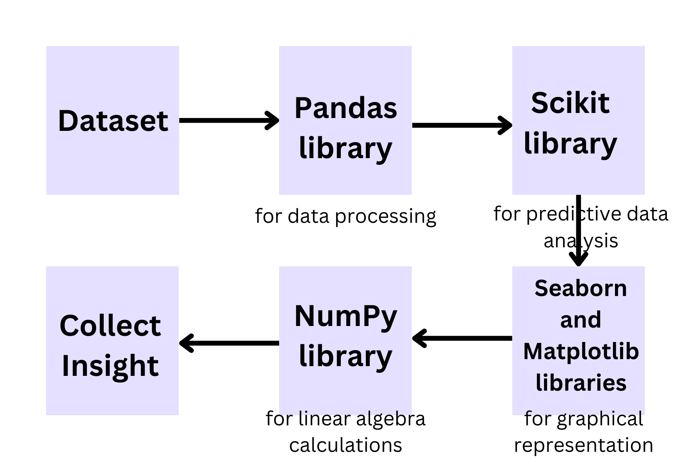
Proposed Methodology Architecture
Notes:
The dataset of cybercrime in India from 2016 to 2018 is taken as input.
The input dataset is preprocessed using the Pandas library for data processing, including removing missing values, data cleaning, and data normalization.
The preprocessed data is then fed to the Scikit library for predictive data analysis. The Scikit library uses various machine learning algorithms such as linear regression, decision trees, and random forests to predict future cybercrime rates in India.
The output of the Scikit library is then visualized using Seaborn and Matplotlib libraries for graphical representation. This includes various types of plots, such as line graphs, bar graphs, and scatter plots, to showcase trends and patterns in the predicted cybercrime rates.
Finally, the NumPy library is used for linear algebra calculations, such as calculating the mean and standard deviation of the predicted cybercrime rates.

Slide 9
Discussion on Proposed Methodology
Data Collection and Pre-processing
Trend Analysis
Trend analysis identifies the rate of change of cybercrime over time, and detect any underlying patterns or trends in the data that may be useful for predicting future cybercrime rates.
Data is collected from various sources, such as police reports or cybercrime databases.
The data is pre-processed to ensure data quality, consistency, and completeness
Data Mining
Data Visualization
Data mining techniques is used to identify patterns and trends in cybercrime data, which can help to predict future crime rates and take proactive measures to prevent cyber threats.
The output is displayed visually using various data visualization techniques, such as line charts, bar graphs, scatter plots. These visual representations can help to communicate the insights gained from the data analysis to users in a clear and concise manner.

Slide 10
Experiments and Results
The name of the dataset: State-wise Cybercrime in India dataset
Reference: The dataset was obtained from the National Crime Records Bureau (NCRB) website: http://ncrb.gov.in/
The experiments were conducted on a computer running Windows 10 operating system with Intel Core i5 processor and 8GB RAM. Python version 3.8 was used along with several libraries such as Pandas, Matplotlib, and Scikit-learn for data analysis, visualization, and prediction tasks. The Colab Notebook environment was used for code development and execution.

Slide 11
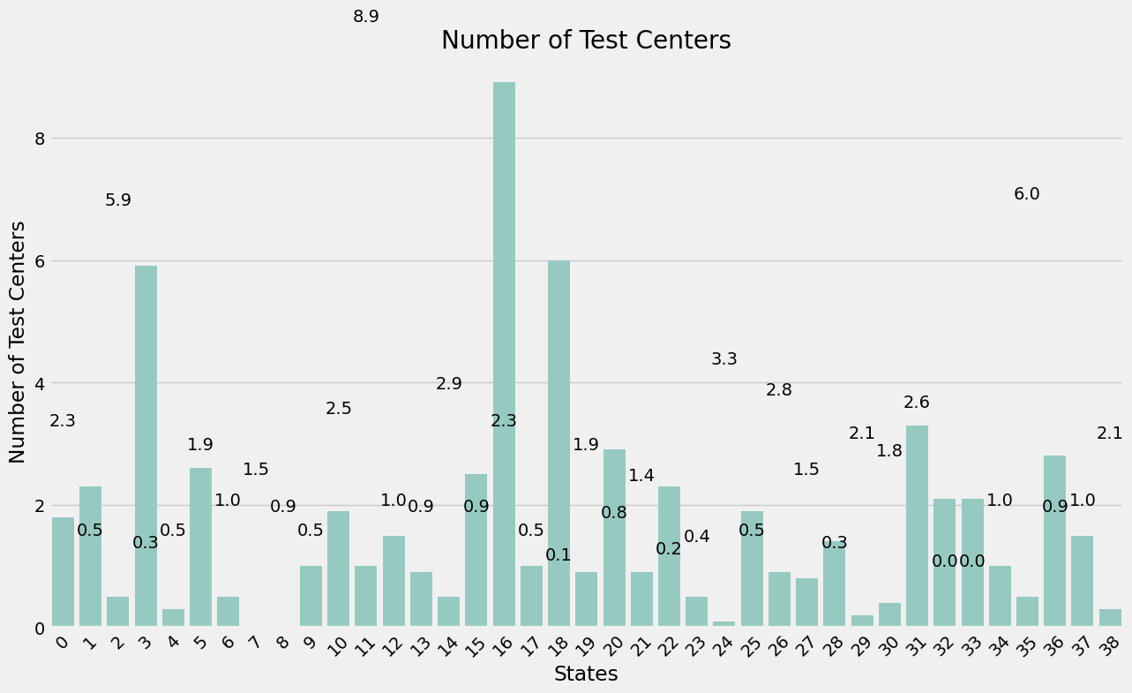
Experiments and Results

Slide 12
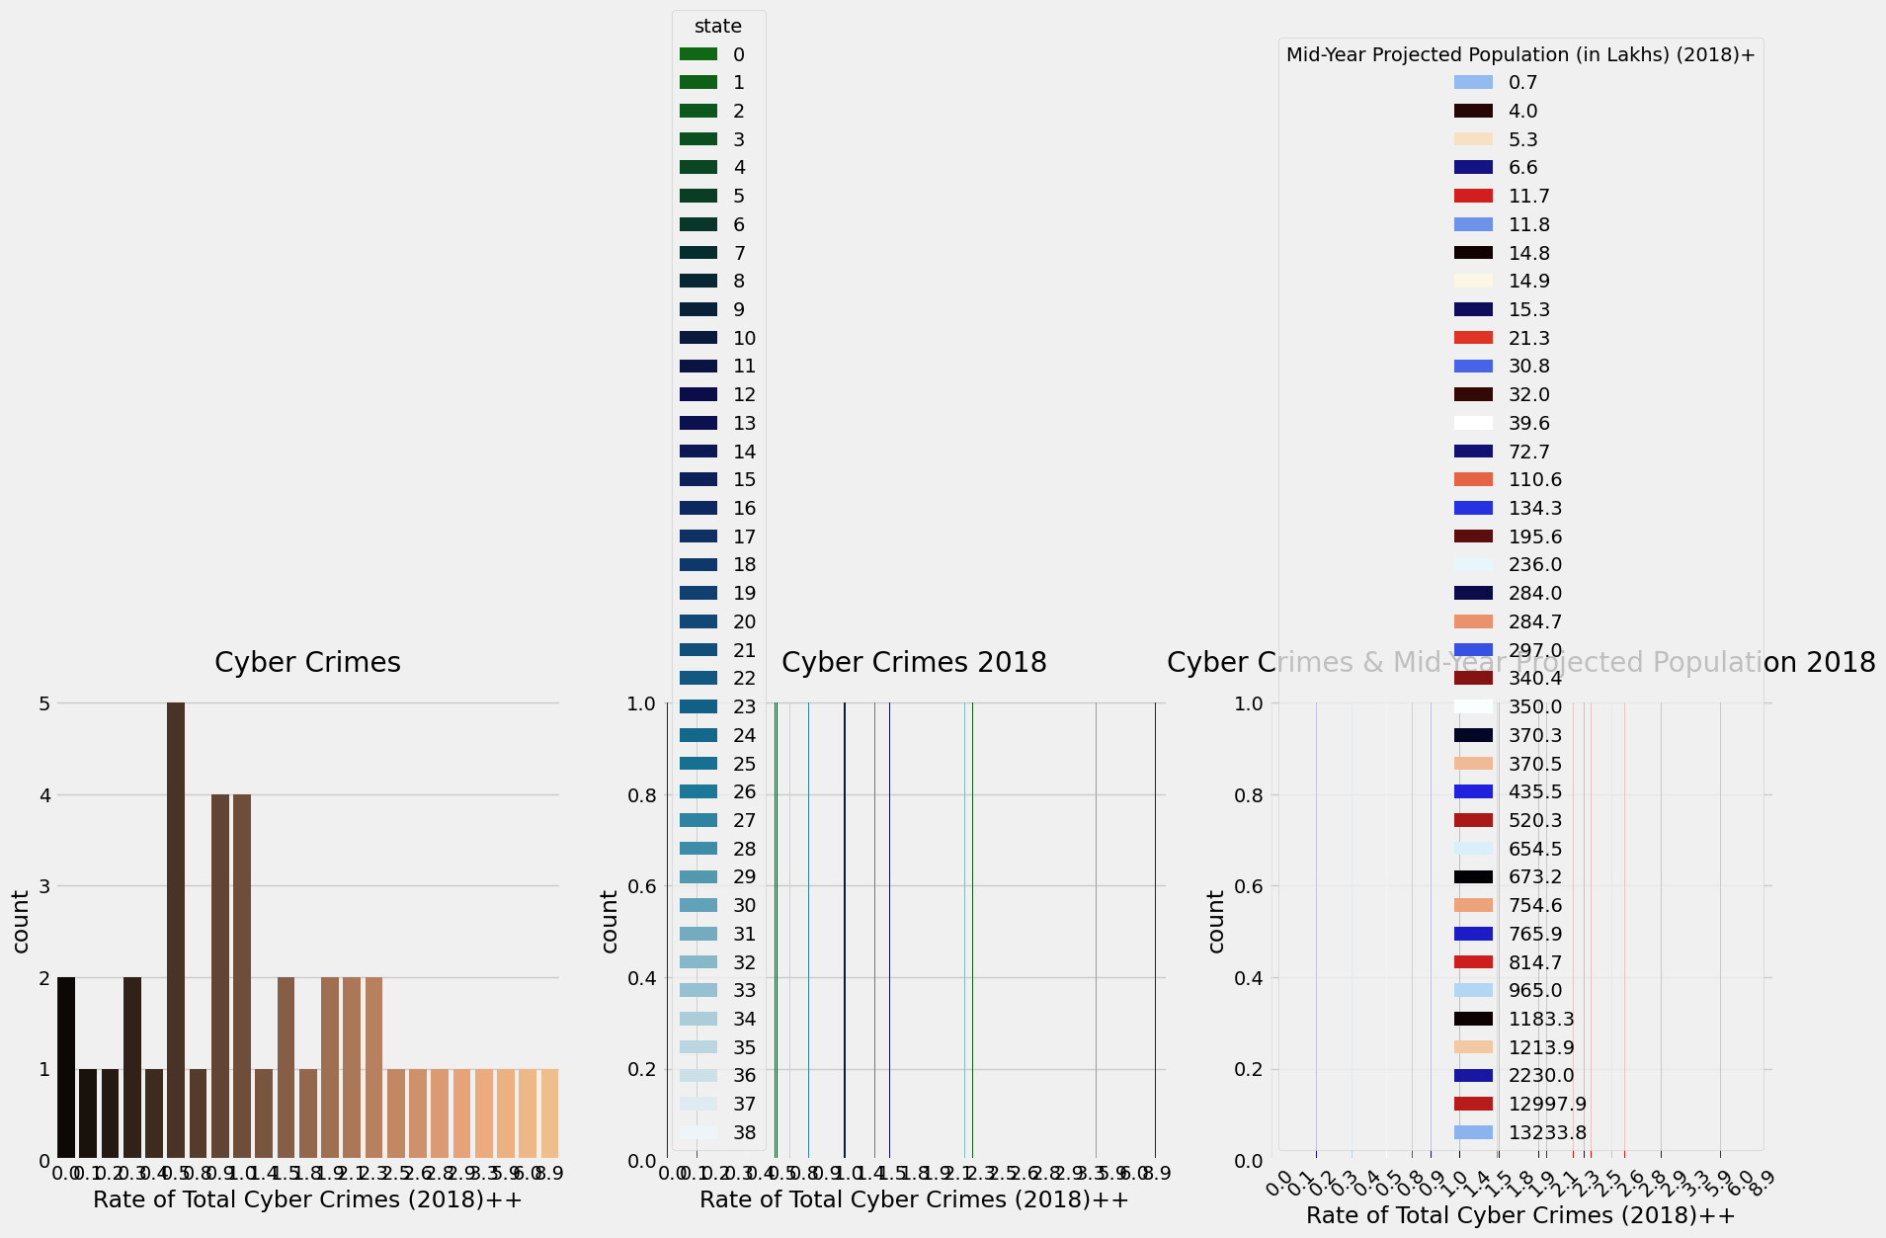
Experiments and Results

Slide 13
Conclusion and Future Work
Summary
01
The project successfully demonstrated the use of digital forensics and data mining techniques to predict cybercrime rates in India
03
The data visualization techniques used in the project helped to identify patterns and trends in cybercrime rates
02
The results showed a significant increase in cybercrime rates during the pandemic lockdown in 2020
04
The project highlights the importance of cybersecurity measures to ensure the confidentiality, integrity, and availability of digital data.
The dataset used in this project only covers a limited time period, and future work can include the collection of more data to increase the accuracy of the predictions.

Slide 14
References
[1] National Crime Records Bureau - https://ncrb.gov.in/en/crime-india
[2] Python for Data Analysis: Data Wrangling with Pandas, NumPy, and IPython by Wes McKinney
[3] Cyber Crime Investigations Handbook by Mr. Rahul Tyagi
[4] Singh, J., & Garg, S. (2019). Cyber Crime Prediction: A Data Mining Approach. In 2019 International Conference on Intelligent Computing and Control Systems (ICCS) (pp. 69-74). IEEE

Slide 15



Any Queries

Slide 16
Thank You

